Slide 1
Object-oriented model with UML III (Class diagram)
Zhang Jinyu – zjy@bjtu.edu.ch
School of Computer and Information Technology
SD 408

Slide 2
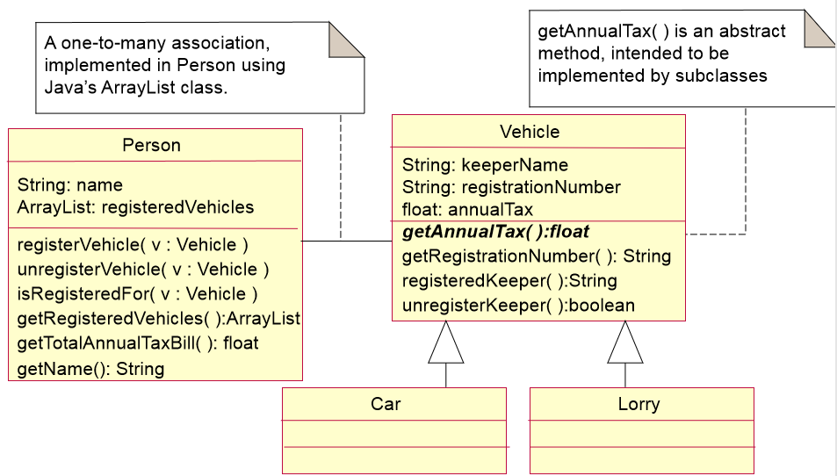
Class diagrams

Slide 3
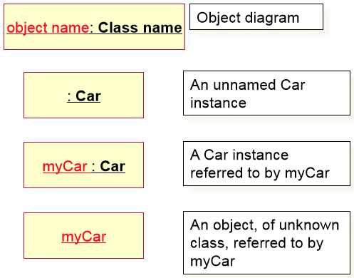
Object diagrams
On an object diagram, an object is shown as a rectangle with an underlined name
An interconnection between two objects (e.g. association or dependency) is represented as a simple line

Slide 4
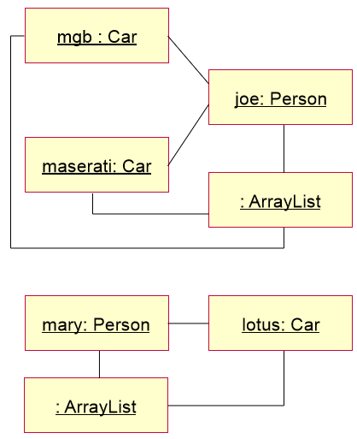
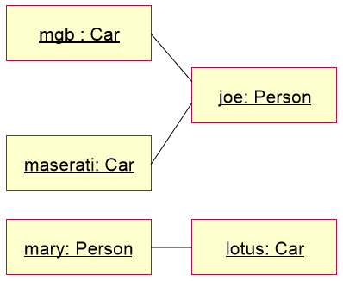
Object relationship diagrams

Slide 5
Contact Book
An organization has commissioned you to develop a contact book application to keep the names, email addresses and phone numbers of their contacts.
The organization has both local and overseas contacts.
The system has the following requirements:
– It shall allow the user to create a new contact
– It shall store the language of an overseas contact in addition to the contact’s other details. It shall store preferred name
– It shall allow the user to edit contact details
– It shall allow the user to add a contact to the contact book and to remove a contact
– It shall allow the user to search for a contact by name or email address

Slide 6
Task:
Identify possible object classes for the contact book application – Also identify possible attributes and operations for each class. – Show the relationships between the object classes, including inheritance and aggregation.

Slide 7
Identifying object classes, attributes & operations
An organization has commissioned you to develop a contact book application to keep the names, email addresses and phone numbers of their contacts.
The organization has both local and overseas contacts.
The system has the following requirements:
– It shall allow the user to create a new contact
– It shall store the language of an overseas contact in addition to the contact’s other details. It shall store preferred name
– It shall allow the user to edit contact details
– It shall allow the user to add a contact to the contact book and to remove a contact
– It shall allow the user to search for a contact by name or email address

Slide 8
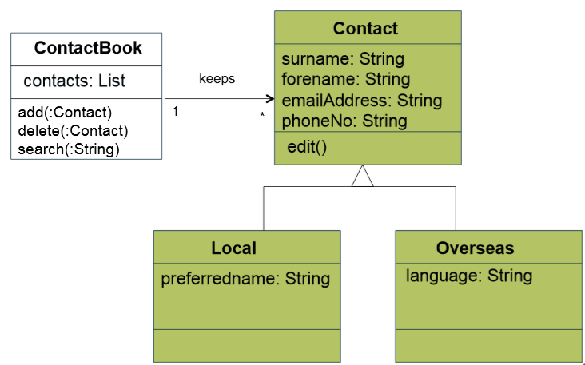
Class diagram for ContactBook Application
继承

Slide 9
Question？

